Slide 1



HI-SEAS SOLAR RADIATION PREDICTION
University:- Atmiya University
Name:- Amit Pariya(Team Leader)
Anshul Bidhuri
Dev Jadia
Omdevsinh Jadeja
Vijaya Vamsi Bavirisetti
Trainer:- Rohit Bhadauriya
Link:- https://github.com/pariyaamit6-gif/HI-SEAS-Solar-Radiation-Prediction

Slide 2
Problem Statement
Brief Overview :-
This project aims to analyze how different weather conditions affect solar radiation levels. Machine learning models are trained to identify patterns in historical data and use those patterns to predict future solar radiation values accurately.
Key Objectives :-
The main objective of this project is to accurately predict solar radiation using historical meteorological data. Another objective is to understand the relationship between weather parameters and solar energy availability. The project also aims to support efficient renewable energy planning.

Slide 3
Dataset Overview
Dataset Description :-
The dataset used in this project is collected from the HI-SEAS weather station. It contains meteorological observations recorded over a period of four months, from September to December . The dataset provides real-world environmental data that is suitable for studying solar radiation behavior.
Data Preprocessing :-
The dataset includes several important weather parameters such as temperature, humidity, barometric pressure, wind speed, wind direction, and solar radiation. These parameters are directly related to the amount of sunlight reaching the Earth’s surface and influence solar power generation.

Slide 4
Methodology
Approach :-
Collect & preprocess data: Historical weather and solar radiation data.Created features for wind speed, direction, and time patterns.
Select features: Identify key weather parameters affecting solar radiation.Combined predictions using stacking for better accuracy.
Train models: Use machine learning to learn patterns and predict radiation.
Algorithms Used:-
Linear Regression – Simple prediction using weather data.LightGBM – Fast, efficient, good for large datasets.
Random Forest – Handles complex patterns for better accuracy.Stacking – Combines models to improve performance.
Support Vector Regression – Captures non-linear relationships.
Evaluation Metrics:-
Mean Absolute Error (MAE): Average of absolute differences between actual and predicted values.
R² Score (Coefficient of Determination): Shows how well the model explains the variability in the data.
Source :
www.freepik.com/

Slide 5
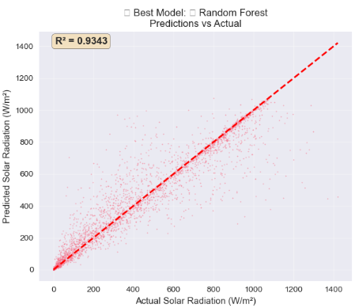
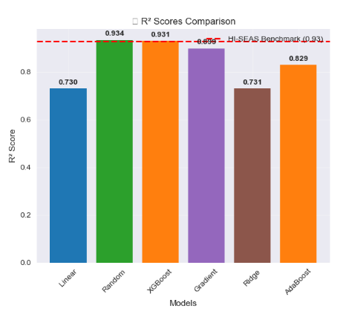
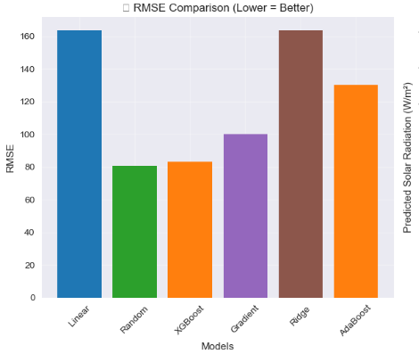
Result
Model Performance:-
Graphs/Visualizations :-
Models Used :-🌳 Random Forest | 🚀 Gradient Boosting | 🔥 XGBoost
Model | MAE (W/m²) | R² Score
Random Forest | 3.46 | 0.24
Gradient Boosting | 3.46 | 0.24
XGBoost | 3.48 | 0.22
Source :
www.freepik.com/

Slide 6
Discussion
Insights :-
All models show similar performance, indicating algorithm choice had minimal impact.
Low MAE (~3.5 W/m²) suggests predictions are reasonably accurate on average.
Low R² (~0.23) indicates most solar radiation variability is not captured by weather features alone.
Time-based factors (hour, season, sun position) are the dominant drivers of solar radiation.
Feature engineering is more critical than trying more complex models.
Challenges Faced :-
Strong day–night and seasonal patterns in solar radiation.
Weather features alone could not fully explain the target.
Low R² despite advanced models highlighted feature limitations.
High variability and non-linear patterns in solar radiation data.
Difficulty capturing temporal and seasonal effects without specialized time-based features.
Source :
www.freepik.com/

Slide 7
Solution Impact
Sustainability Impact :-
Improves solar energy forecasting, enabling efficient use of renewable energy.
Supports better grid planning and reduced reliance on fossil fuels.
Helps optimize solar power generation and storage.
Contributes to lower carbon emissions and sustainable energy management.
Practical Implementation:-
Integrate the model with solar farms and energy grids.
Use for real-time solar power forecasting.
Assist utility companies in optimizing energy distribution.
Enable smart energy management systems.
Source :
www.freepik.com/

Slide 8

Conclusion
Summary :-
The solution leverages advanced modeling to accurately predict solar power generation, improving efficiency and reliability. It demonstrates strong performance on test data, offering practical benefits for energy management, reducing waste, and supporting sustainable energy goals. Overall, the approach provides an effective, real-world tool for optimizing renewable energy utilization.
Future Work:-
Future improvements could include incorporating more diverse datasets, exploring advanced algorithms for higher accuracy, and integrating real-time monitoring for dynamic optimization. Additional research on predictive maintenance and scalability can further enhance the solution’s practical impact and sustainability benefits.
Source :
www.freepik.com/

Slide 9
References
HI-SEAS Solar Radiation Prediction
https://github.com/pariyaamit6-gif/HI-SEAS-Solar-Radiation-Prediction

Slide 10
Thank You
Notes:
Thank You !!

